Slide 1
SQL SERIES- ZERO TO HERO- DAY 2
Devikrishna r

Slide 2
What we will cover today?
What is Data?
What is a Database?
What is DBMS[Database Management System]?
What is RDBMS[Database Management System]?
What is SQL?
What are a Table and fields?
What is Primary Key?
What is a Unique Key?
What is Foreign Key?
Differences Between Spreadsheets and Database?
Relational vs Non-Relational DB vs Cloud Database?
What are SQL Commands?
Explain types of SQL Commands?

Slide 3
What we will cover today?
What are the datatypes of SQL for beginners?
What is normalization?
What is denormalization?
Difference between Drop and Truncate statement?
Differentiate between the DELETE and TRUNCATE commands.
What are aggregate and scalar functions?
Expain ACID properties?
What is Database Schema?
What is view in SQL?
What is Trigger?

Slide 4
What are the datatypes of sql for beginners?
VARCHAR
DATE
INT
FLOAT
BOOLEAN

Slide 5
Why normalization in sql?
It is a process of removing redundancy from the data for enhanced data integrity.
Normalization in SQL is mainly used to reduce the redundancy of the data.
The data which is present in the database should be in the normalized form before it is processed further.
That’s why normalization in SQL improves the data distribution in the database.
It helps in reducing the amount of unwanted data from the database.
The dependent data should be stored together.
There should not be any unwanted data.

Slide 6
First Normal Form (1NF)
Second Normal Form (2NF)
Third Normal Form (3NF)
Fourth Normal Form (4NF)

Slide 7
What is denormalization?
Denormalization is a technique used to access the data
from higher to lower normal forms of the database. It is also a
process of introducing redundancy into a table by incorporating data from the related tables.

Slide 8
What is the difference between DROP and TRUNCATE statements?
TRUNCATE removes all the rows from the table, and it cannot be rolled back. DROP command removes a table from the database and the operation cannot be rolled back.

Slide 9
Differentiate between the DELETE and TRUNCATE commands.
DELETE :
command is used to remove rows from the table, and the WHERE clause can be used for conditional set of parameters.
Commit and Rollback can be performed after deleting statement.
TRUNCATE :
removes all rows from the table.
Truncate operation cannot be rolled back.

Slide 10
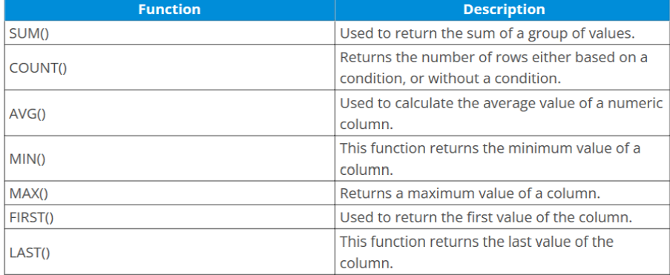
What are aggregate and scalar functions?
Functions are methods used to perform data operations.
Aggregate Functions:

Slide 11
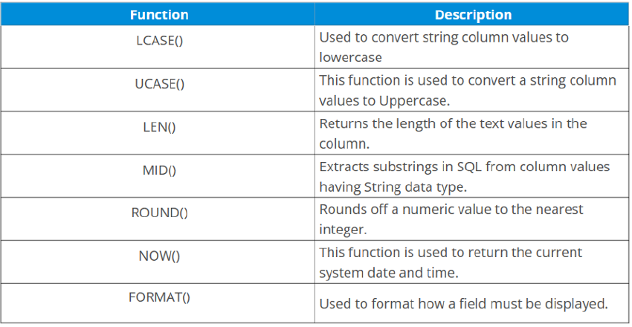
scalar functions

Slide 12
List and explain each of the ACID properties
Atomicity : A transaction is a single unit of operation. You either execute it entirely or do not execute it at all.
There cannot be partial execution.
Consistency: Once the transaction is executed, it should move from one consistent state to another.
Isolation : Transaction should be executed in isolation from other transactions. During concurrent
Transaction execution, the intermediate transaction results from simultaneously executed transactions
should not be made available to each other.
Durability : After successful completion of a transaction, the changes in the database should persist, even in the case of system failures.

Slide 13
What is database schema?
The database schema is the structure of a database described in a formal language supported by the database management system (DBMS).

Slide 14
What are views in SQL?
A view is a virtual table that consists of a subset of data contained in a table.
Views are not virtually present, and it takes less space to store.
View can have data of one or more tables combined.
it is depending on the relationship.

Slide 15
What is a trigger?
A DB trigger is a code or programs that automatically execute with response to some event on a table or view in a database.
Mainly, trigger helps to maintain the integrity of the database.

